Slide 1
Inference Systems:
vLLM Architecture
Introduction to Deep Learning: Class 5.7

Slide 2
vLLM
vLLM is a high-throughput and memory-efficient inference and serving engine for Large Language Models (LLMs)
Addresses unique challenges involved in generative LLM serving
Originally developed in the Sky Computing Lab at UC Berkeley, vLLM has grown into one of the most active open-source AI projects with over 2000 contributors
Distributed as a Python package (can be pip installed)
Can be used standalone (vllm serve) or integrated in user’s Python code
Can be integrated with other serving systems, eg Ray Serve

Slide 3
Agenda
User / Client
OpenAI-compatible API, Python SDK, batch/offline inference
Recap transformer architecture
KV caching
Paged attention
Continuous batching
Prefix caching
Prefill-Decode disaggregation
Speculative decoding
Compiled CUDA graphs
vLLM serving/runtime layer
request intake, streaming outputs, cancellation, metrics
vLLM engine core
scheduler, continuous batching, KV-cache manager, prefix cache, block table, model execution coordination
GPU worker / model executor
runs transformer layers, handles TP/PP/DP/EP communication
Per-layer kernels
attention kernels, GEMM kernels, MoE kernels, norm kernels, quantization kernels, sampling kernels

Slide 4
Why does this matter?
SLM serving for CDA using Ray + vLLM
Original vLLM + Ray configuration: 1200 ms
Split out vLLM and Ray (initialize vLLM engine within Ray replicas): - 20%
Use mp backend for vllm:
Harmony template changes
Adjust max_model_length, max_num_batched_tokens per use-case
Use C++ HA Proxy in Ray
Speculative decoding techniques
Merge suffix decode tree across replicas
Skip quantizing sliding window KV vectors:
Optimized CUDA graphs: ~250 ms

Slide 5
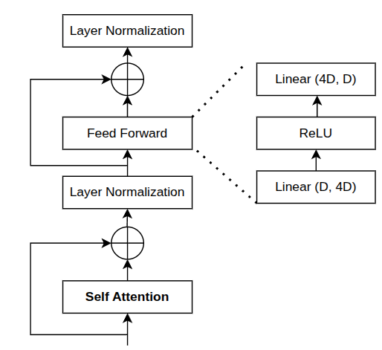
Quick Recap: Transformer Architecture
Next token distribution
Softmax
Attention Block
Outputs contextualized embeddings
Feed Forward: Mixes info across embedding (channel) dimension with non-linearities
Skip Connection: Stable optimization, don’t destroy previous representation
LayerNorm: Keeps activations well-scaled, learning stable
T, V
FC layer
T, H
Transformer
input
e1+p1 | e2+p2 | e3+p3 | e4+p4 | e5+p5 | e6+p6 | e7+p7 | e8+p8 | e_pad+p9 | e_pad+p10 | e_pad+p11 | e_pad+p12
Trainable token + position embeddings
1 | 1 | 1 | 1 | 1 | 1 | 1 | 1 | 0 | 0 | 0 | 0
Attention mask
t1 | t2 | t3 | t4 | t5 | t6 | t7 | t8 | pad | pad | pad | pad
Tokenization
Input Sentence

Slide 6
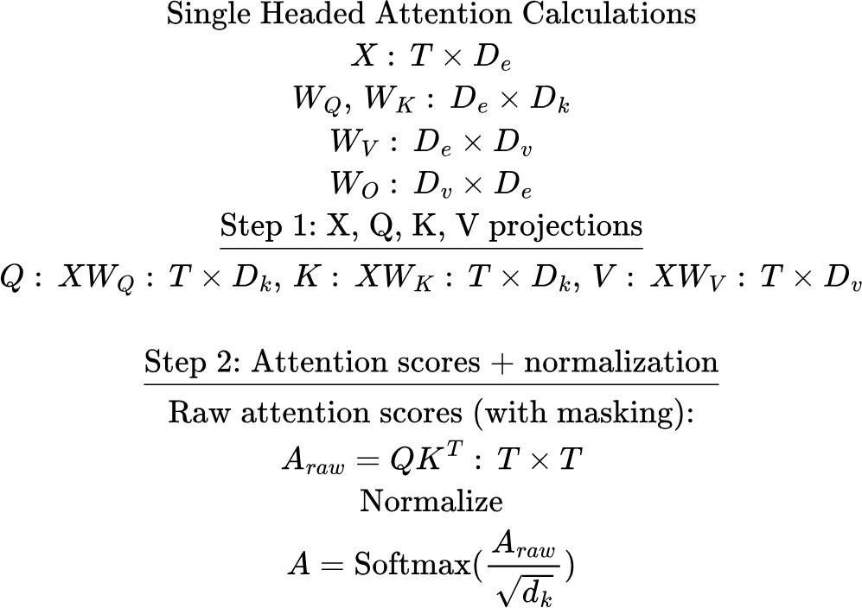
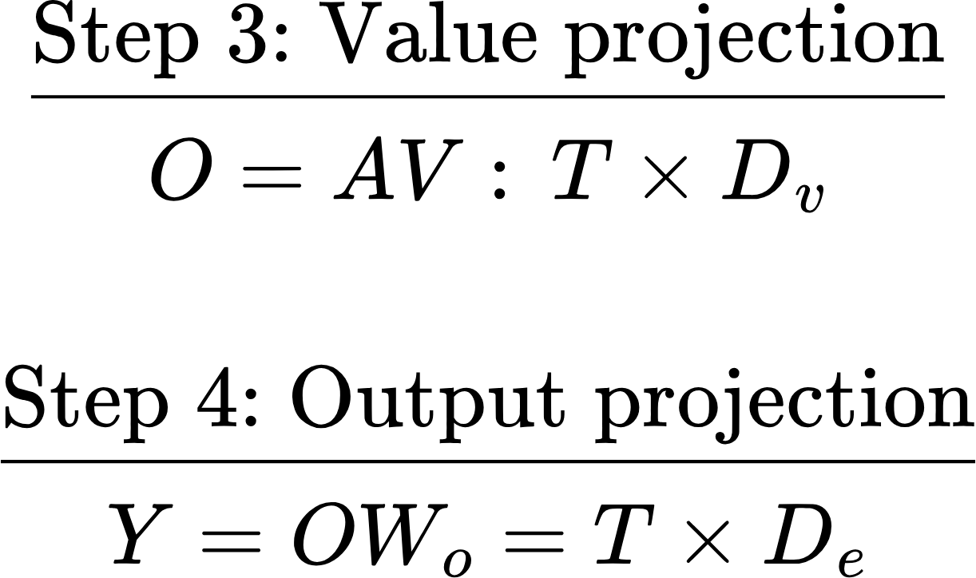
Attention Summary

Slide 7
Generative Model: Inference
Key idea: Autoregressively generate one token after the other
fox
jumps
over
Decoding: Sample a token
Decoding
Decoding
Probability distribution over tokens: p(t)
p(t)
p(t)
Transformer + FC + Softmax
Transformer+ FC + Softmax
Transformer+ FC + Softmax
<BOS>, The, quick, brown _
<BOS>, The, quick, brown, fox _
<BOS>, The, quick, brown, fox, jumps _
Prefill
Decode
Decode

Slide 8
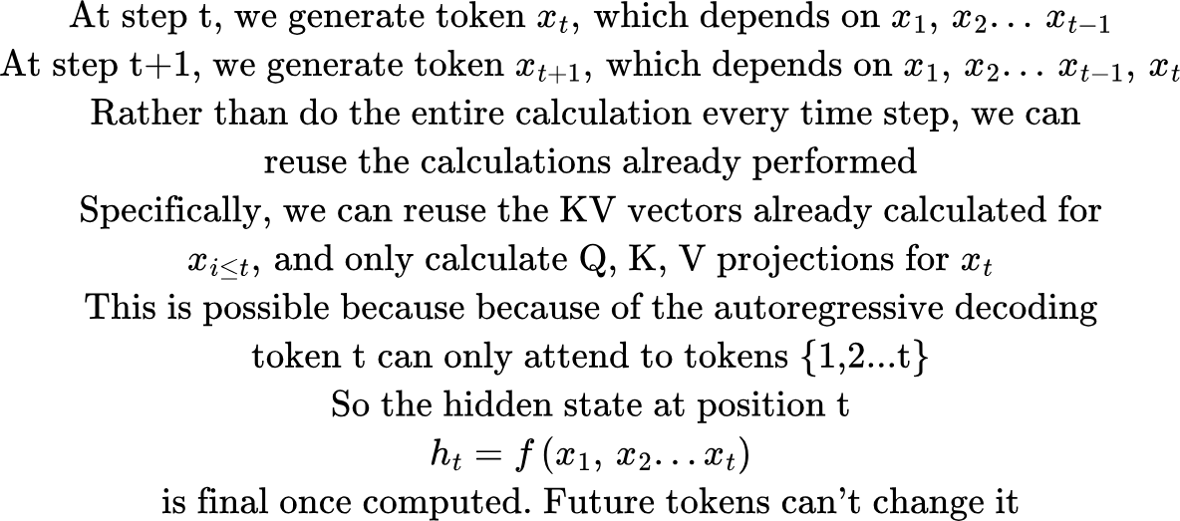
KV Caching
The quick brown -> fox
The quick brown fox -> jumps
Storing the previously calculated KV vector is called KV caching.

Slide 9
LLM Inference: Prefill and Decode
LLM inference has two phases:
Prefill: process the input token, fill the KV cache. Compute bound, because we can process a large number of tokens in parallel.
Decode: Generate new tokens autoregressively. Memory bound, because lot of KV data must be transferred to the compute units (streaming microprocessors on a GPU)
For one request:
Prompt tokens -> Prefill, generate first token -> decode 1 -> decode 2 … -> until EOS or some threshold is exceeded

Slide 10
Size of KV cache
D: Head dimension
H: Num Heads
Layer N
…
N layers
Layer 2
Layer 1
Birds fly home [PAD] [PAD] [PAD]
The cat chased mice [PAD] [PAD]
A small dog barked loudly [PAD]
The children played outside after lunch
B = 4, T = 6

Slide 11
Issues with KV caching: Memory Fragmentation
Size of the cache per sequence: [seq len, num layers, num heads, head dimension]
As decoding proceeds, sequence length grows token by token. KV vectors are calculated for the current token are added to the cache. Thus, KV cache memory grows linearly, and is needed for the entire request
In a real serving system
Many requests
Each with different prefix lengths
Each with different number of generated tokens.. We don’t know a priori when generation would end

Slide 12
Memory Fragmentation
You allocate one big block per sequence
Request A: 2048 tokens
Request B: 512 tokens
Request C: 4096 tokens..
If I reserve a block of 4K tokens, that wastes memory for A and B, but not enough for C. I’ll have to reallocate another bigger block, and copy the KV cache in the middle of decode!
Example
Block size: 6
Internal fragmentation
External fragmentation
OOM
Request 1
Request 2
birds | fly | home | <eos> |  |  |  |  | The | cat | chased | mice | <eos>
A | small | dog | barked | loudly | <eos> |  |  | The | children | played | outside | after | lunch | <eos>
Request 3
Request 4

Slide 13
Paged attention
Key idea: Instead of each sequence owning its own contiguous memory block, it maintains a logical view of several small physical blocks
Physical KV Cache
Page size = 3
Block table row: idx // page_size
Row offset: idx % page_size
 | 0 | 1 | 2
0 | The | children | played
1 | outside | after | lunch
2 | mice | eos
3
4 | The | cat | chased
5 | eos
Request B:
The children played outside after lunch eos
Request A:
The cat chased mice eos
Block table row: 4 // 3 = 1
0
1
5
4
2
lunch
Block table row: 5 // 3 = 1
Block table offset: 5 % 3 = 2
Row offset: 4 % 3 = 1
No need to guess seq len. Just request new blocks from the paged cache. Increment ref count of the block. When completion finishes, reduce ref count. Physical pages with ref count = 0 will be recycled as needed.

Slide 14
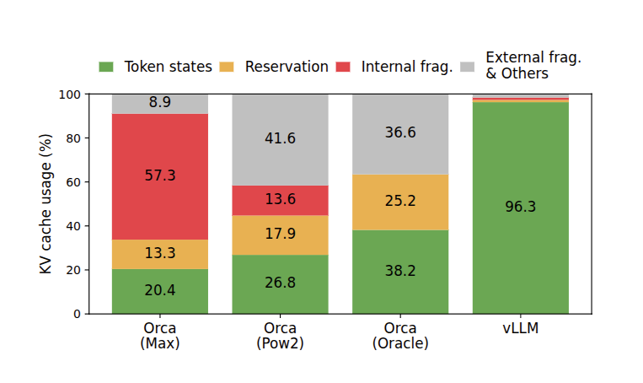
Paged Attention: Impact
Source: https://arxiv.org/pdf/2309.06180

Slide 15
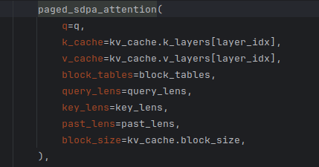
Paged Attention
The attention backend must be able to deal with non-contiguous memory blocks
 | 0 | 1 | 2
0 | four | score | and
1 | outside | after | lunch
2 | mice
3
4 | seven | years | ago
5 | our
fathers
Query vector

Slide 16
Chunked prefill + continuous batching
LLM inference has two phases:
Prefill: process input tokens, fill the KV cache. Compute bound, because we can process a large number of tokens in parallel.
Decode: Generate new tokens autoregressively. Memory bound, because lot of KV data must be transferred to the compute units (streaming microprocessors on a GPU)
For one request:
Prompt tokens -> Prefill, generate first token -> decode 1 -> decode 2 … -> until EOS or some threshold is exceeded

Slide 17
The problem..
Real servers have several requests at different stages
Request A: already decoding
Request B: new long prompt, needs prefill
Request C: already decoding
Request D: new short prompt
Request E: Almost done

Slide 18
Static Batching
You collect requests into a batch and then process it all together, which means waiting until the entire batch processing is finished. Works well when the the execution time per request is roughly the same
Not so for LLM serving. Consider:
Current batch:
A: generate 10 tokens B: generate 40 tokens C: generate 20 tokens
We’ll need to wait 40 steps until the batch is done.. All the while requests D, E.. are waiting, and GPU is heavily underutilized because decode is memory bound

Slide 19
Continuous batching + Chunked prefill
Revisit the current batch every engine step and adjust
Which new requests are ready to be admitted?
How many tokens can I process?
How much kv cache memory is available?
Which requests are finished and can be removed?
Batch size is no longer static!

Slide 20
Continuous Batching and Chunked Prefill: Example
t=0: Request A: prompt length = 100, num generated tokens = 10
t=1: Request B: prompt length = 50, num generated tokens = 5 Request C: prompt length = 60, num generated tokens = 10
max_num_batched_tokens = 60
Step 1: prefill first 60 tokens in request A (chunked prefill)
Step 2: prefill remaining 40 tokens in A, generate first token. Prefill 20 tokens in request B
Step 3: Decode 1 token in A, prefill 30 tokens in B, 29 tokens in C
Without chunked prefill, I would have processed all 100 prompt tokens in request A, increasing TTFT for requests B and C

Slide 21
Continuous Batching and chunked prefill
Key parameters:
max_num_batched_tokens: total number of tokens to consider in each vllm step. Should be set such that the total GPU compute is used for throughput sensitive applications. A smaller number will lower the latency per step (tokens might generate faster for sequences in decode, but overall throughput may fall as prefill takes longer)
max_num_seqs: maximum number of sequences to include in a batch
max_model_len: maximum total sequence length vllm will handle, including prompt tokens and generated tokens. Lower max_model_len means less memory reserved for K/V cache, hence more memory available during decode

Slide 22
Prefix Caching
Do not recompute the KV cache for prompt tokens that have already been processed before. Reuse the cached KV blocks.
Eg: Prompt 1 System: You are a helpful assistant. User: Here is a long document… Question: Summarize the document.
Prompt 2: System: You are a helpful assistant. User: Here is a long document… Question: Extract the main entities.
Instead of calculating K/V cache again for prompt 2, reuse the kv cache for the shared prefix

Slide 23
Prefix caching
Eg: Prompt 1 Assistant: You are a helpful assistant. User: Here is a long document… Question: Summarize the document.
Prompt 2: System: You are a helpful assistant. User: Here is a long document… Question: Extract the main entities.
Prefix caching can’t be used here.. K/V cache of subsequent tokens depend on the previous tokens..
Prefix caching only improved prefill, hence TTFT. Doesn’t affect decode. To improve decode performance, a different class of techniques are used: speculative decoding

Slide 24
Prefix caching
Prompt 1: [A, B, C, D, E, F, G, H, I, J]
KV cache blocks:
Block 0: [A, B, C, D] Block 1: [E, F, G, H] Block 2: [I, J, _, _]
Prompt 2: [A, B, C, D, E, F, G, H, I, K]
Only full blocks are used, so K/V for I won’t be used Prompt 3: [A, B, C, C, E, F, G, H, I, J]: No match, even though E, F, G, H match block 1

Slide 25
Prefix caching Implementation
Prompt 1: [A, B, C, D, E, F, G, H, I, J, K, L]
Block 0: [A, B, C, D] -> hash(ABCD) Block 1: [E, F, G, H] -> hash(hash(block0) + EFGH) Block 2: [I, J, K, L] -> hash(hash(block1) + IJKL)
Sequence [A, B, C, D, E]: hash (ABCD) -> hit, increment ref count for block 0, allocate KV cache block for E
Sequence [B, A, C, D, E]: hash (BACD) -> no hit
Sequence [A, B, C, D, E, F, G, H, K]: hits for block 0, 1, increment their ref count, allocate KV cache for K
Sequence [A, B, D, D, E, F, G, H, K]: No hits! Even though E,F,G,H match

Slide 26
Prefix Caching: Security consideration
Prefix caching can leak information through timing in multi-tenant settings.
If user B can send a prompt and observe that it is much faster, they might infer that someone else recently used the same prefix.
To mitigate this, vLLM supports cache salting through cache_salt that is injected into the first block hash so that only requests with the same salt can reuse cached KV blocks. This isolates cache sharing to an intended trust group.

Slide 27
Prefill-Decode Disaggregation
For large models and context lengths, it may make sense to separate prefill and decode on different GPUs, that share KV cache
Prefill
GPU 1
Large compute
High-speed GPU interconnect
Decode
GPU 2
Large VRAM

Slide 28
Advanced Features
CUDA Graph compilation
During a forward pass, for every generated token, several CUDA kernels (matmul, flash attention, non-linearities etc) need to be launched. This can be a significant overhead, where the amount of computation per kernel launch is relatively low (as in decode)
Solution: Capture the sequence of kernel launches.. Kernel A -> B -> C, and replay, i.e., do one consolidated kernel launch rather than many individual launches
Speculative decoding:
Some tokens are easier to guess than others. Instead of asking the target model to generate all tokens one by one, use a smaller draft mechanism to propose several likely tokens at once, then use the target model to validate all the draft tokens at once. Keep the draft tokens until the point where the target and draft begin to disagree.
vllm supports several speculative decoding techniques. Some use a smaller model (eagle, medusa..) others are model-less (suffix decoding)

Slide 29
Engine.schedule: which requests to handle in this scheduler step
Create chunks: decode first, then prefill

Slide 30
Forward pass: Input preprocess
3 requests have cached prefix lengths: 0, 3, 6, chunk lengths: 2, 4, 3
Calculate max chunk len: 4
Allocate a B, 4 tensor, fill with paddings, add tokens
Create a position tensor, needs to reflect true position of the tokens, reflecting prompt tokens computed so far. These are needed to calculate rope embeddings correctly
We run the forward pass for the entire tensor, and then mask out the invalid input tokens
0 | 1
3 | 4 | 5 | 6
5 | 6 | 7

Slide 31
Filling kv_cache in a batch
3 requests have cached prefix lengths: 0, 3, 6
For each layer,
Allocate a kv-cache of size (12, h, d)
Copy the physical pages from the kv_cache, using per request indices in the block table. Limit the copy to the cached prefix lengths for each request
Now the materialized kv_cache block will look like this:
Note: we are copying tensors from physical kv cache, not ideal

Slide 32
Adding new K/V for Query chunks
3 requests have chunked prefill lengths: 2, 4, 3
Calculate max_sequence_length, including cached kv and chunked prefill = max(2, 7, 9) = 9
Create a B, 9 tensor fill with padding
Calculate new k/v vectors corresponding to max_chunk_len (for each request, only the k/v until the query_len will be valid..).
Arrange each row of kv as: valid_past | valid_current_chunk | padding
Key_len tells us how much is real, how much padding
Cu_seq_len_q: [0, 2, 6, 9]

Slide 33
Create attention mask
B, 1, max_query, max_key
Not a jagged mask per sequence
The 1 is for broadcasting across multiple attention heads
For sequence 2,
 |  |  |  | -inf | -inf | -inf | -inf | -inf
 |  |  |  |  | -inf | -inf | -inf | -inf
 |  |  |  |  |  | -inf | -inf | -inf
 |  |  |  |  |  |  | -inf | -inf

Slide 34
Create attention mask
 |  |  |  |  |  |  | -inf | -inf
 |  |  |  |  |  |  |  | -inf
-inf | -inf | -inf | -inf | -inf | -inf | -inf | -inf | -inf
For seq 3
Talk about sliding window attention

Slide 35
Decode
For decode, we just need to calculate kv for the last decoded token.. So input_ids is the last token for each request.

Slide 36
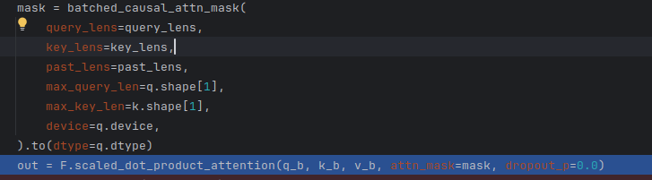
Calling attention
query_lengths = [2, 4, 3]
Past_lens = [0, 3, 6]: cached k/v len per sequence
key_lengths = [2, 7, 9]: note: doesn’t have to be the sum of query_len + past_len.. Eg., for sliding window attention!

Slide 37
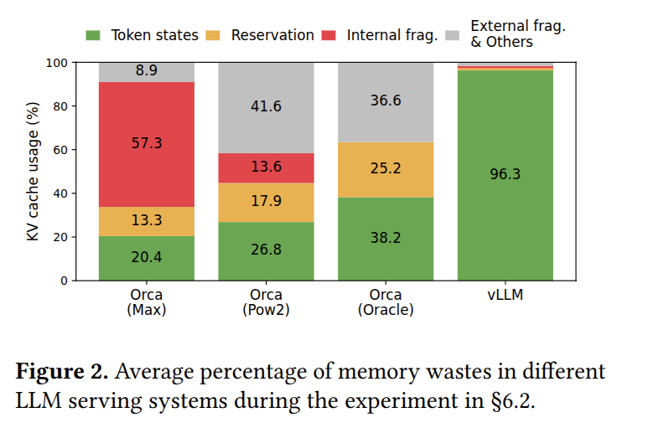
Paged Attention: Memory Savings

Slide 38
vLLM and FlashAttention
User / Client
OpenAI-compatible API, Python API, batch/offline inference
vLLM serving/runtime layer
request intake, streaming outputs, cancellation, metrics
vLLM engine core
scheduler, continuous batching, KV-cache manager,prefix cache, block table, model execution coordination
GPU worker / model executor
runs transformer layers, handles TP/PP/DP/EP communication
Per-layer kernels
attention kernels, GEMM kernels, MoE kernels, norm kernels, quantization kernels, sampling kernels

Slide 39
vLLM and FlashAttention
Sampling kernel
MLP: matmul kernel
Output Projection: matmul kernel
Attention: FlashAttention kernel
QKV Projection: matmul kernel
RMS/LayerNorm kernel
For each transformer layer
Input token embedding lookup, position embeddings

Slide 40
Arithmetic Intensity
Arithmetic Intensity (AI): How much computation we do per unit of data moved
AI = FLOPs/Bytes moved
High AI: Lot of math per unit data moved, compute bound
Low AI: Little math per unit data moved, memory bandwidth-bound
Examples
y = x + 1: just one calculation for 1 R/W
Matrix Multiplication: High AI (each row/col is used to calculate several elements of the output matrix)

Slide 41
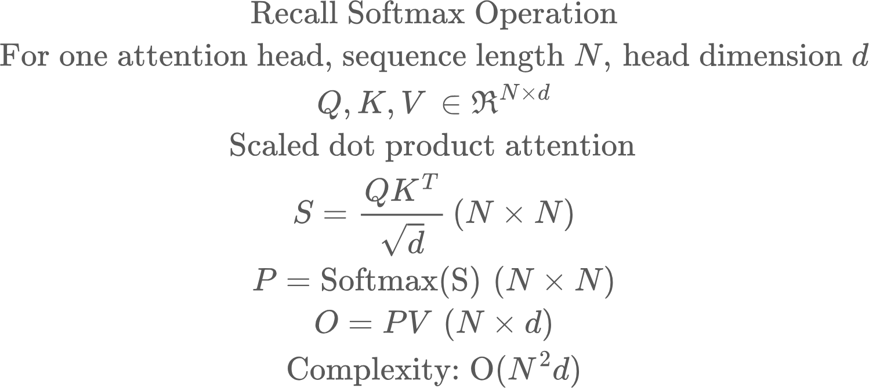
FlashAttention

Slide 42
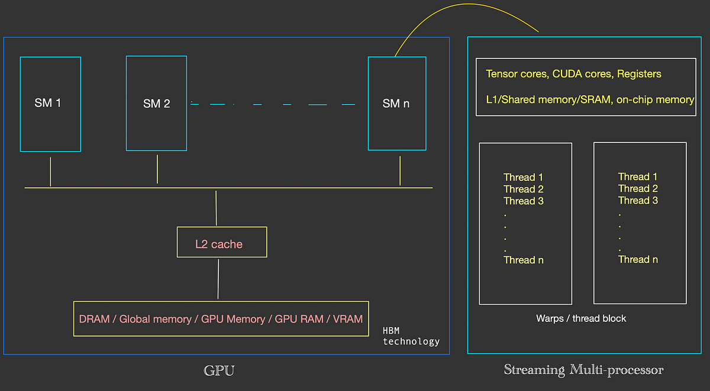
GPU Architecture
Streaming Microprocessors (SM): Where calculations happen
SRAM: Local data storage
DRAM: Global memory, but data must be transferred to SRAM for compute

Slide 43
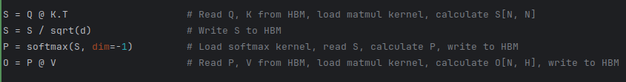
Attention: Naive Implementation
Problem 1: The intermediate matrices can be huge.
Say N = 8192, then each attention matrix (fp16) = 8192*8192*2 bytes ~134 MB
This much data must be written back and forth for every attention head for every layer for every sequence in the batch

Slide 44
Attention: Naive Implementation
Problem 2: Multiple kernel launches, which also precludes sharing data, as one kernel can’t access previous kernel’s SRAM

Slide 45
Solution: Tiling, Streaming and Kernel Fusion
Flash Attention does two big things:
Do not make the GPU remember the whole attention matrix. Stream through it in tiles and accumulate the final answer.
Fuse the various calculations in attention into a single kernel. This is called kernel fusion

Slide 46
Tiled multiplication
Recall what we are doing in the attention operation
For a query vector, we calculate the dot product against all the key vectors to get raw attention scores
We normalize the scores
We calculate a weighted average of the value vectors with the attention scores as the weights
Let’s say we didn’t have the normalization

Slide 47
Tiled multiplication
Read first two columns of the key matrix
Read first two columns of the value matrix
Query vector
Divide K, V matrices into blocks
Given a query vector,
Initialize output vector
For every K, V block:
Calculate dot product between query and K block
Use the coefficients to calculate weighted average of V block
Accumulate weighted average into the output vector
Write output vector back to HBM
Advantage: I’m reading less data each time (B*D for each block), the full matrix multiplcation vector doesn’t need to be materialized.

Slide 48
Tiled multiplication
The idea can easily be extended to multiple query rows
Read first three rows of the query matrix
Read first two columns of the key matrix
Read first two columns of the value matrix
Divide K, V matrices into blocks. The block size for K, V must be equal, query block size can be different
Given a query matrix,
Initialize output matrix
For every K, V block:
Calculate dot product between query and K block
Use the coefficients to calculate weighted average of V block
Accumulate weighted average into the output matrix
Write output vector back to HBM
Query matrix

Slide 49
Tiled multiplication
keys
values
Iteration 2
Read first three rows of the query matrix
Iteration 3
Query matrix

Slide 50
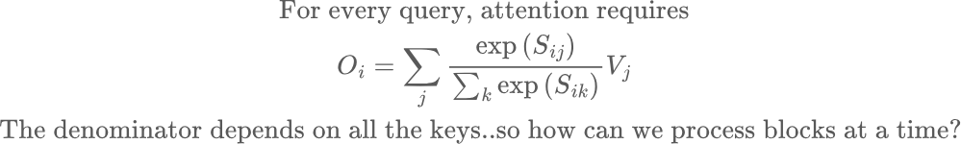
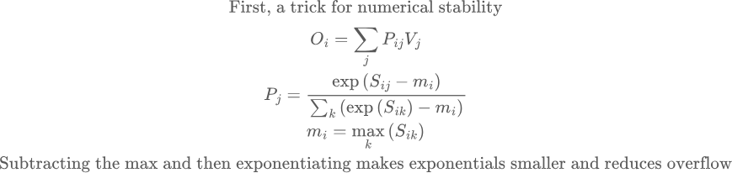
Problem: Softmax

Slide 51
Problem: Softmax
To compute the denominator and the sum, we need all the keys!

Slide 52
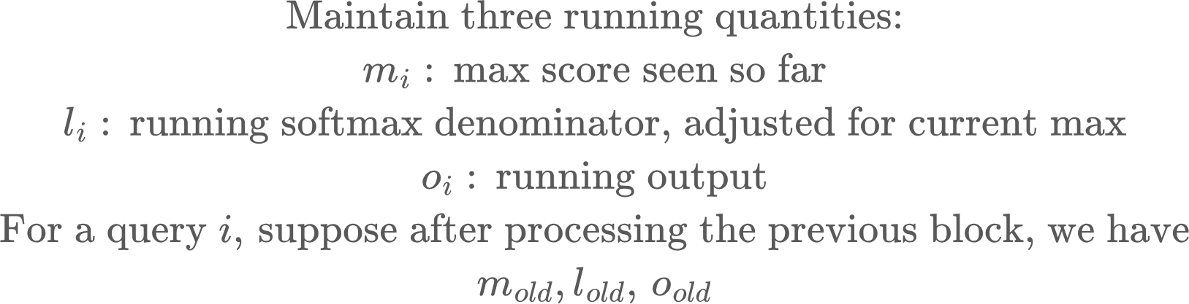
The solution: Online Softmax
Core idea: Maintain running counters that are updated as K, V are streamed in, such that the final output is the same

Slide 53
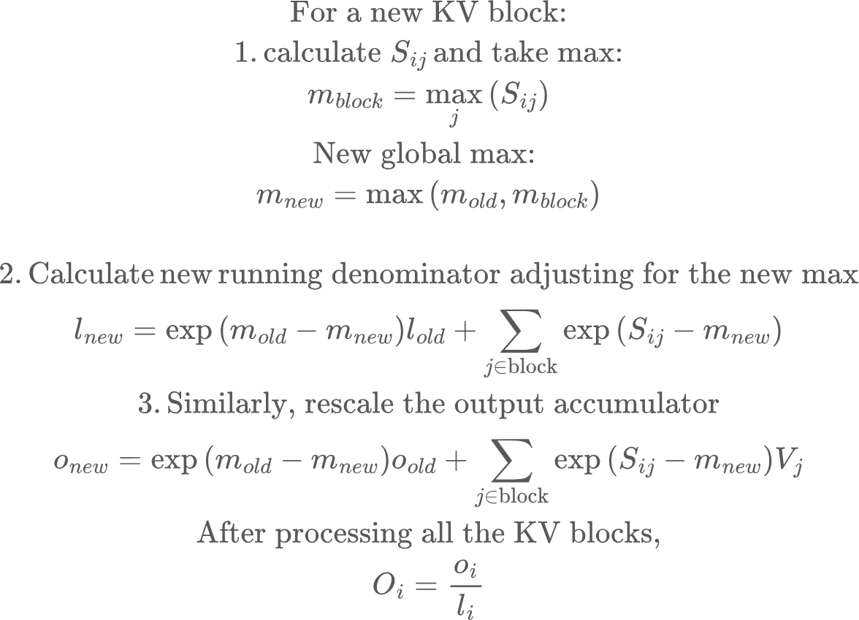
The solution: Online Softmax
Note: the running averages can stay in SRAM, as KV blocks are streamed in to the same FlashAttention kernel. No new kernel launches

Slide 54
FlashAttention: Summary
Traditional attention is slow because:
Materializes N^2 intermediates
Repeatedly moves them through HBM between separate kernels. HBM may be large enough to store them, but the bandwidth cost of writing and rereading them is huge.
FlashAttention fuses the attention computation and uses tiled online softmax so each small score tile is created on-chip, consumed immediately, and never written to HBM.

Slide 55
Training vs Inference
Training requires forward and backward pass, and avoiding the N,N attention matrix was a key enabler in making long-context training possible. Adapting the backprop math in the backward pass to FlashAttention is tricky!
For Inference prefill, we process the entire prompt at once, and FlashAttention is critical to lower TTFT
For Inference decode, we are calculating attention score of the current token wrt previous KV cache.. So the attention matrix is only 1,N and FlashAttention is less important.
Decode is dominated by reading KV cache from memory, so paged attention, kv cache layout become more important..

Slide 56
Prefix to block mapping
By storing entries keyed by the entire prefix up to that block, not just by the block contents.
So if block_size = 4 and prompt is:
block 0: A B C D
block 1: E F G H
block 2: I J K L
then the cache stores mappings like:
(A,B,C,D) -> block_id_0
(A,B,C,D,E,F,G,H) -> block_id_1
(A,B,C,D,E,F,G,H,I,J,K,L) -> block_id_2
That is why prefix_len keeps growing. On lookup:
for block_idx = 0, it asks “do I have the first full block of this prompt?”
for block_idx = 1, it asks “do I have the first two full blocks of this prompt?”
and so on
If any longer prefix is missing, lookup stops.

Slide 57
Continuous Batching and chunked prefill
Another consequence of continuous batching and chunked prefill is that we are no longer passing padded sequences to the model
Before:
Bird fly home pad pad Children played in the sand The cat caught mice pad
Now:

